Slide 1


Mixture Models and EM
Chen Haibin
Lab of Machine Learning and Data Mining
South China University of Technology

Slide 2
Outline
Part 1 K-means Clustering
Part 2 EM Algorithm
Part 3 EM for Gaussian mixtures

Slide 3

Part 1 K-means Clustering
Our goal is topartition the data set into number K of cluster ->
each data point to its closest vector {μ_{k}},is a minimum
distortion measure
(if {x_{n}} is assigned to cluster k then r_{nk}=1)

Slide 4

Part 1 K-means Clustering
1.choose some initial values for the μ_{k}.
2.minimize J with respect to the r_{nk} (μ_{k} fixed)
assign thenthdata point to theclosest cluster centr
3.minimize J with respect to the μ_{k} (r_{nk}fixed)

Slide 5


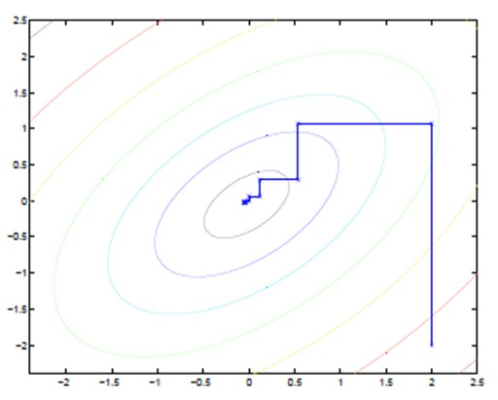
Part 1 K-means Clustering
3.minimize J with respect to the μ_{k} (r_{nk}fixed)
→
the mean of all of the data points x_{n} assigned to cluster k
4.repeated until convergence...

Slide 6
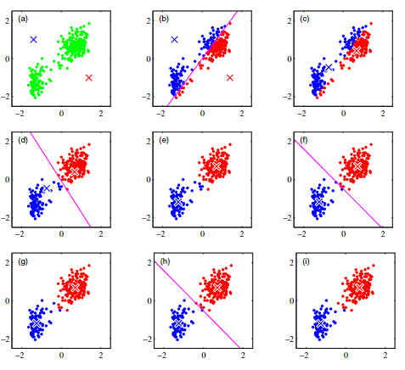
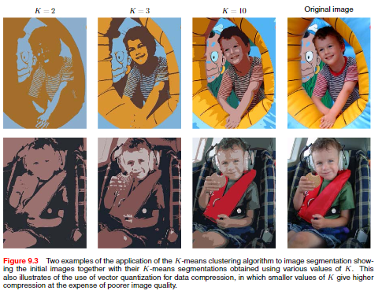
Part 1 K-means Clustering

Slide 7
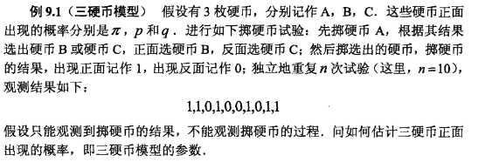



Part 2 EM Algorithm
一次试验的概率:
似然函数:
包含未知变量并有包含和的对数，难以求出解析解。关于潜在变量Z的取值的知识仅仅来源于后验概率分布p(Z|X;θ)，是不完整的。

Slide 8

Part 2 EM Algorithm
取初值 Π₀=0.4，p₀=0.6，q₀=0.7
u₁ = 1/10 * ((0.4*0.6/0.4*0.6+0.6*0.7)+(0.4*0.4/0.4*0.4+0.6*0.3))
= 0.4064
更新为[0.36,0.36,0.47...]

Slide 9
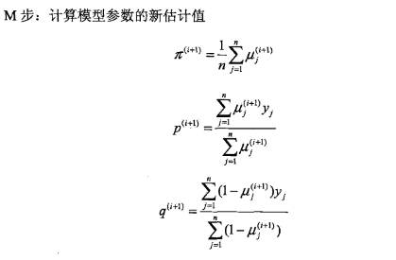
Part 2 EM Algorithm
Π₁=0.4064
p₁=0.36*6/sum(u)=0.5368
q₁=(1-0.36)*6/sum(1-u)=0.6432

Slide 10
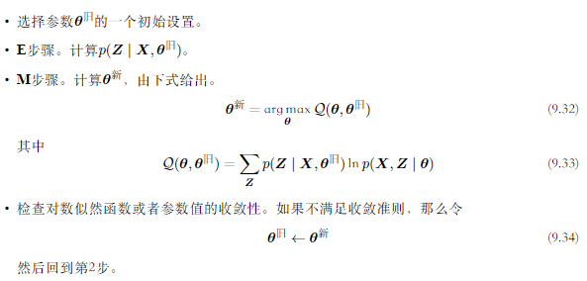
Part 2 EM Algorithm
1.参数初值可任意选择
2.每次迭代实际在求Q函数极大

Slide 11
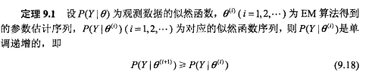
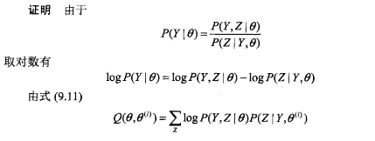
Part 2 EM Algorithm
EM 算法的证明

Slide 12
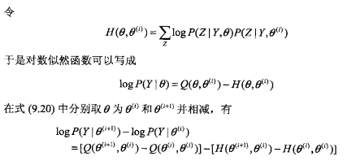
Part 2 EM Algorithm
EM 算法的证明
以下证明Q函数单调递增、H函数单调递减

Slide 13
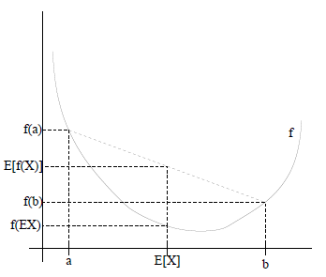
Part 2 EM Algorithm
EM 算法的证明
Jensen不等式
凸函数 E[f(x)] ≥ f(E[x])
凹函数则相反

Slide 14

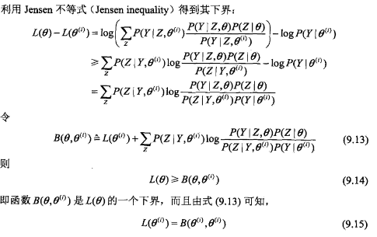
Part 2 EM Algorithm
EM 算法的证明
log为凹函数
f(E[x]) ≥ E[f(x)]

Slide 15
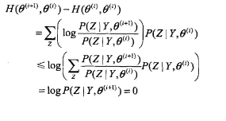
Part 2 EM Algorithm
EM 算法的证明
因此P(Y|θ)单调递增并最终收敛(可能为极大值)
log为凹函数
f(E[x]) ≥ E[f(x)]

Slide 16
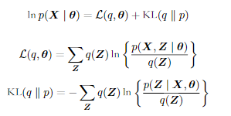
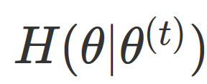
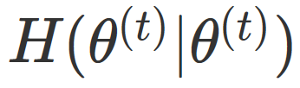
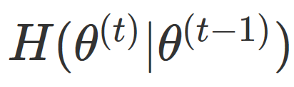
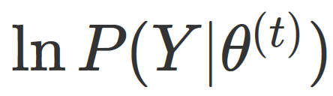
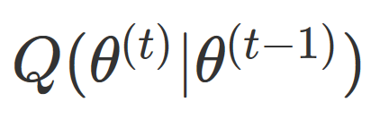
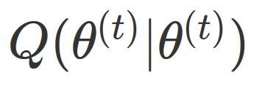
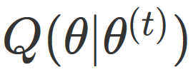
Part 2 EM Algorithm
EM 算法的证明
L(q,θ)is a functional of the distribution q(Z)
Kullback-Leibler di-vergence
e-step
m-step

Slide 17

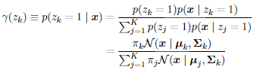

Part 3 EM for Gaussian mixtures
Gaussian mixture distribution:
introduce a K-dimensional binary random variable z z_{k}∈{0,1}and ∑_{k}z_{k}=1
the conditional probability of z given x
γ(z_{k}) : 'responsibility' :k takes for ‘explaining’ the observation x
当前模型参数下第j个观测数据来自第k个分模型的概率

Slide 18
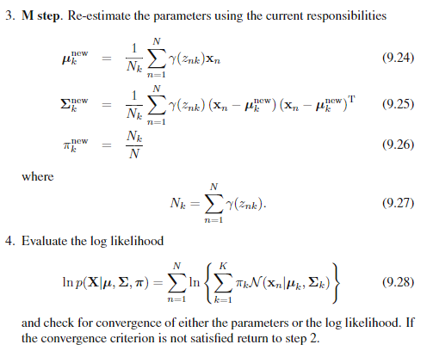
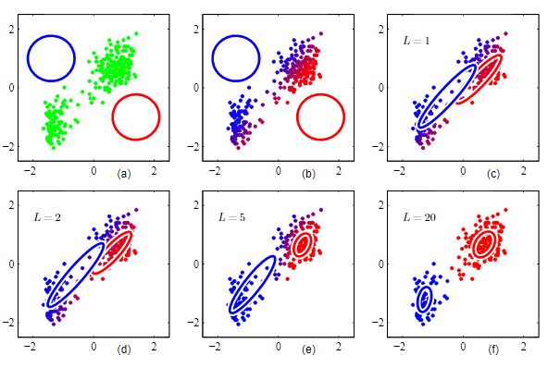
Part 3 EM for Gaussian mixtures

Slide 19


Thanks for your listening ...

